Slide 1
Fair Clustering through Fairlets ( NIPS 2017)
Flavio Chierichetti
Ravi Kumar
Silvio Lattanzi
Sergei Vassilvitskii

Slide 2
Objective
A Fair Clustering algorithm under the Disparate Impact doctrine, where each protected class must have approximately equal representation in every cluster
Formulation of fair clustering under the k-center and k-median objectives

Slide 3
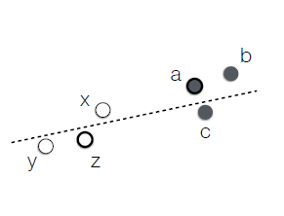
Clustering and Fairness
Given a set X of points lying in some metric space, the goal is to find a partition of X into k different clusters, optimizing a particular objective function
Unprotected- Coordinates, Protected- Color
Disparate impact translates to that of Color Balance in each cluster

Slide 4
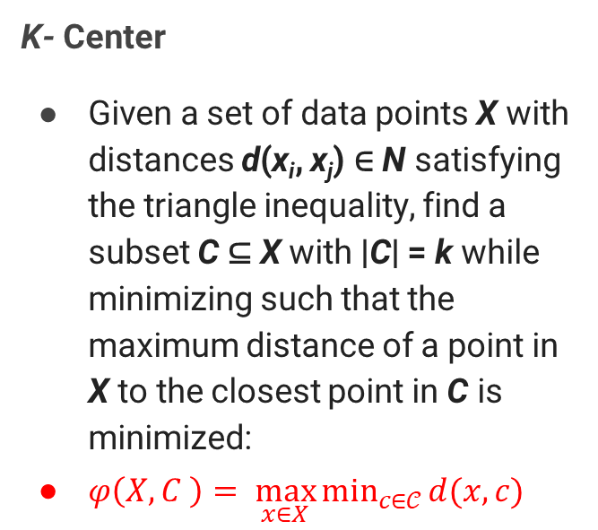
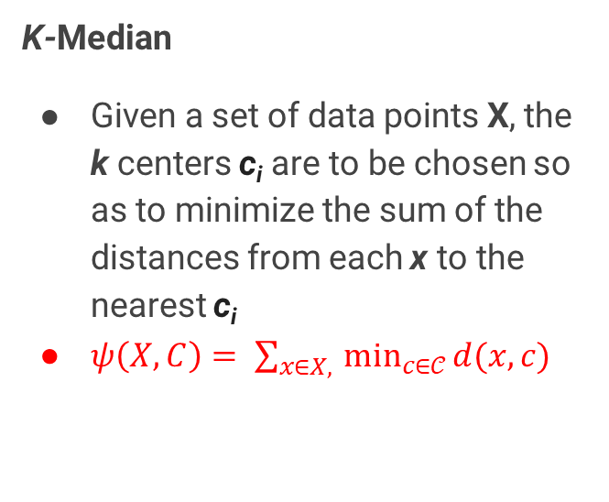
The two objectives
K- Center
Given a set of data points X with distances d(x_{i}, x_{j}) ∈ N satisfying the triangle inequality, find a subset C ⊆ X with |C| = k while minimizing such that the maximum distance of a point in X to the closest point in C is minimized:
$φ\left(X, C \right)= \max_{x∈X}{\min_{c∈𝒞}{d(x, c)}}$
K-Median
Given a set of data points X, the k centers c_{i} are to be chosen so as to minimize the sum of the distances from each x to the nearest c_{i}
$ψ\left(X, C\right)= \sum_{x∈X, }{\min_{c∈𝒞}{d(x, c)}}$

Slide 5
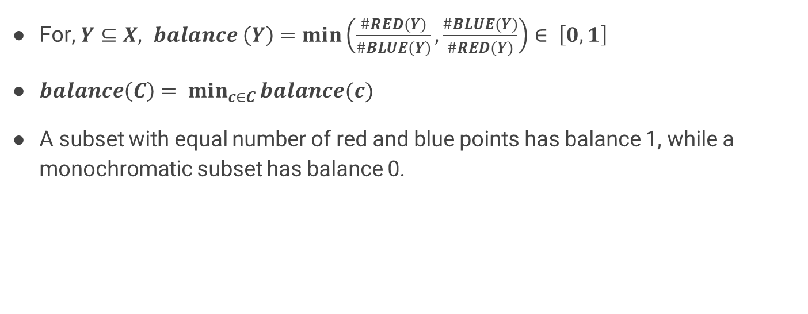
Balance
For, $Y⊆X, balance \left(Y\right)=\min\left(\frac{\#RED(Y)}{\#BLUE(Y)}, \frac{\#BLUE(Y)}{\#RED(Y)}\right)∈ \left[0, 1\right]$
$balance\left(C\right)= \min_{c∈C}{balance(c)}$
A subset with equal number of red and blue points has balance 1, while a monochromatic subset has balance 0.

Slide 6
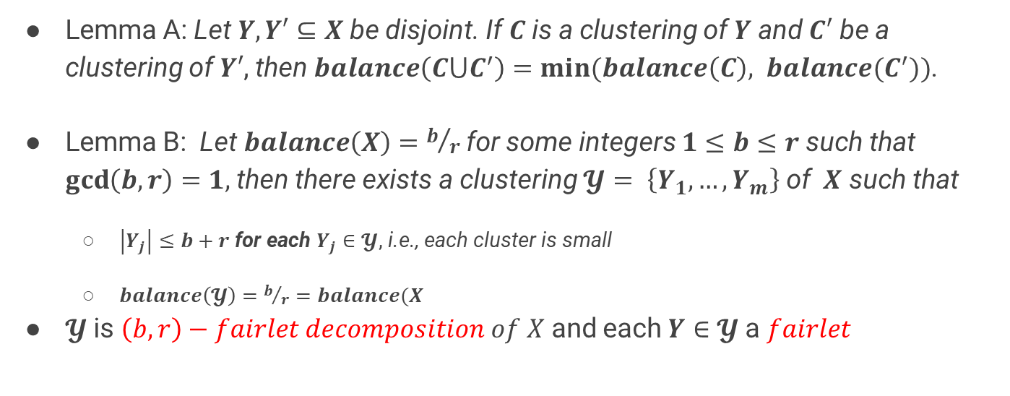
LEMMA
Lemma A: Let $Y, Y′⊆X$ be disjoint. If $C$ is a clustering of $Y$ and $C′$ be a clustering of $Y′$, then $balance\left(C⋃C^{′}\right)=min⁡(balance\left(C\right), balance(C^{′}))$.
Lemma B: Let $balance\left(X\right)=b/r$ for some integers $1≤b≤r$ such that $\gcd\left(b, r\right)=1,$then there exists a clustering $𝓨= \left\{Y_{1}, …, Y_{m}\right\}$ of $X$ such that
$\left|Y_{j}\right|≤b+r$ for each $Y_{j}∈𝓨$, i.e., each cluster is small
$balance\left(𝓨\right)=b/r=balance(X$
$𝓨$is $\left(b, r\right)−fairlet decomposition of X$ and each $Y∈𝓨$ a $fairlet$

Slide 7

$$\left(t, k\right)−fair clustering$$
In the $\left(t,k\right)$-fair center ($resp. (t, k) fair median$) problem, the goal is to partition $X$ into $C$ such that $\left|C\right|=k, balance\left(C\right)≥t, and φ(X, C) (resp. ψ(X, C))$ is minimized.

Slide 8
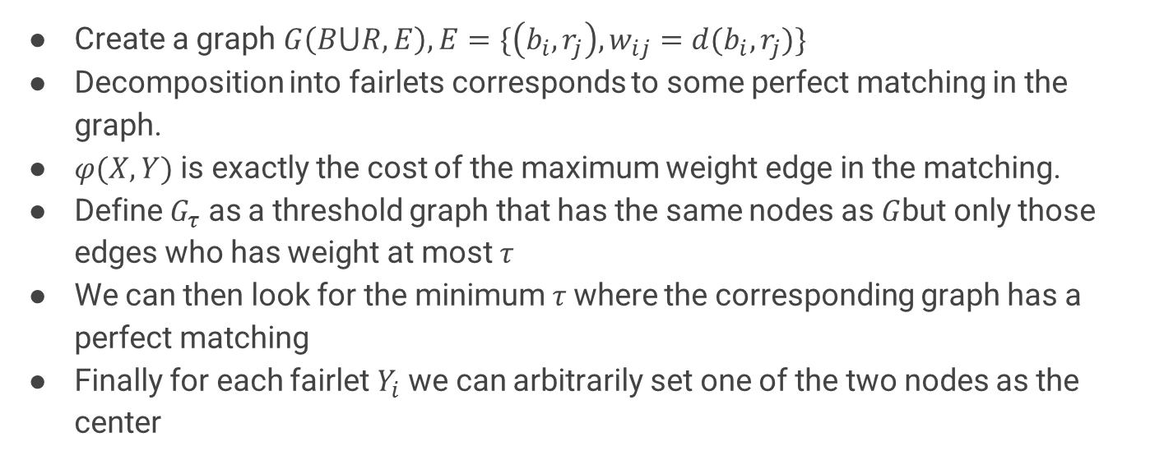
Fair k- center: (1, 1)- fairlets
Create a graph $G\left(B⋃R, E\right), E=\{\left(b_{i}, r_{j}\right), w_{ij}=d(b_{i},r_{j})\}$
Decomposition into fairlets corresponds to some perfect matching in the graph.
$φ(X, Y)$ is exactly the cost of the maximum weight edge in the matching.
Define $G_{τ}$ as a threshold graph that has the same nodes as $G$but only those edges who has weight at most $τ$
We can then look for the minimum $τ$where the corresponding graph has a perfect matching
Finally for each fairlet $Y_{i}$ we can arbitrarily set one of the two nodes as the center

Slide 9
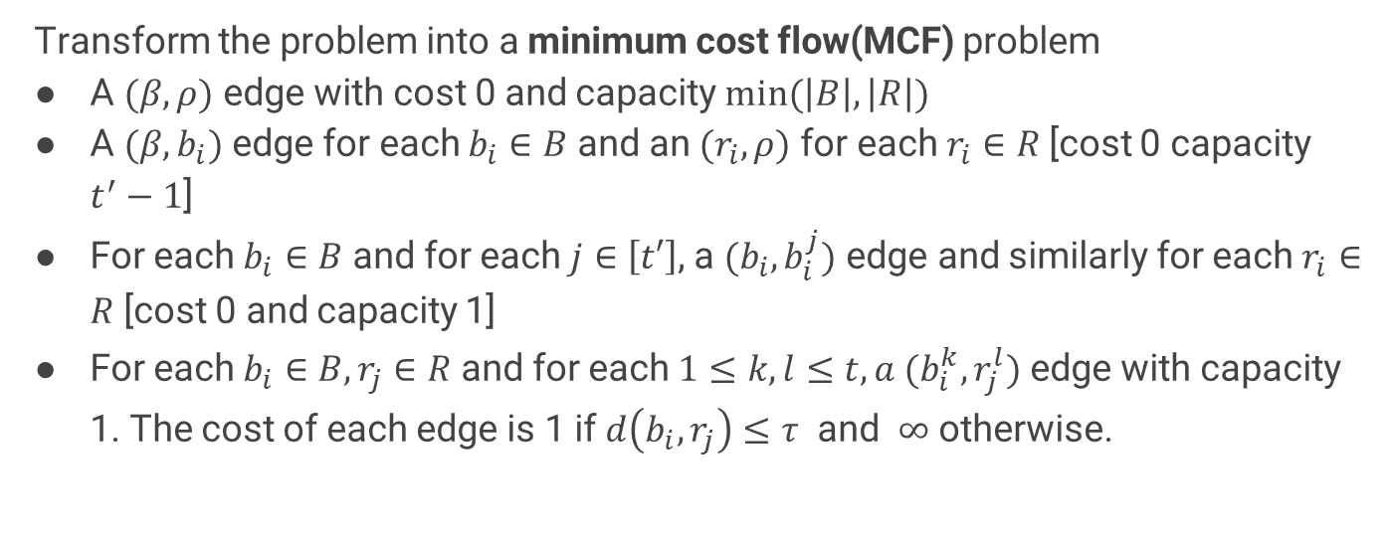
Fair k-center: $(1,t^{′})$-fairlets
Transform the problem into a minimum cost flow(MCF) problem
A $(β, ρ)$ edge with cost 0 and capacity $min⁡(\left|B\right|, \left|R\right|)$
A $(β,b_{i})$ edge for each $b_{i}∈B$and an $(r_{i},ρ)$ for each $r_{i}∈R$[cost 0 capacity $t^{′}−1$]
For each $b_{i}∈B$ and for each $j∈\left[t′\right]$, a $(b_{i},b_{i}^{j})$ edge and similarly for each $r_{i}∈R$ [cost 0 and capacity 1]
For each $b_{i}∈B, r_{j}∈R$ and for each $1≤k,l≤t, a (b_{i}^{k},r_{j}^{l})$ edge with capacity 1. The cost of each edge is 1 if $d\left(b_{i},r_{j}\right)≤τ$ and $∞$ otherwise.

Slide 10
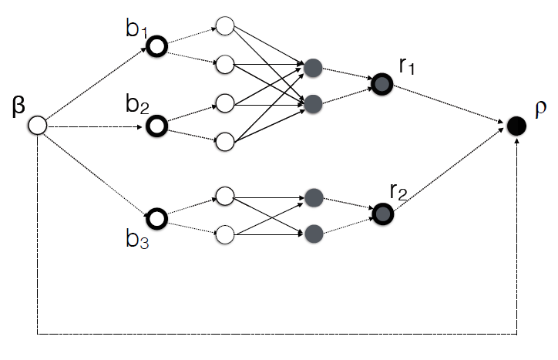
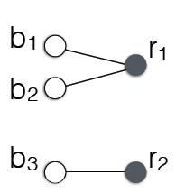
Fair k-center: $(1,t^{′})$-fairlets

Slide 11

LEMMA
Lemma C: Let $𝒴$ be an optimal solution of cost C to the MCF instance, then it is possible to construct a $\left(1, t^{′}\right)$-fairlet decomposition for $(1/{t^{′}}, k)$- fair center problem of cost at most C.

Slide 12

Theorem
For each fixed $t′≥3$, finding an optimal $(1, t^{′})$-fairlet decomposition is NP-hard. Finding the minimum cost $(1/{t^{′}},k)$-fair median clustering is NP-hard.

Slide 13
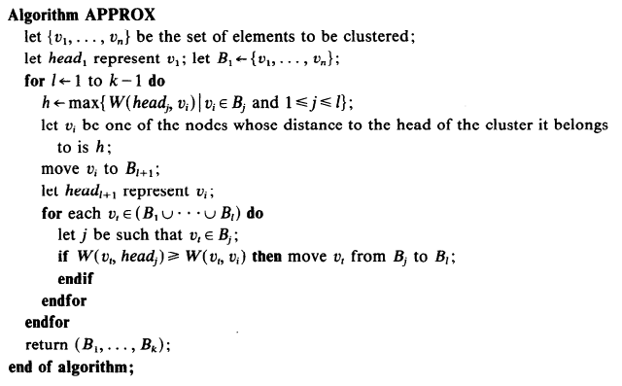
Greedy Furthest point Algorithm

Slide 14
Datasets
Diabetes (1000 records, gender to be balanced)
Bank (1000 records, Married or unmarried to be balanced)
Census (600 records, gender to be balanced)

Slide 15
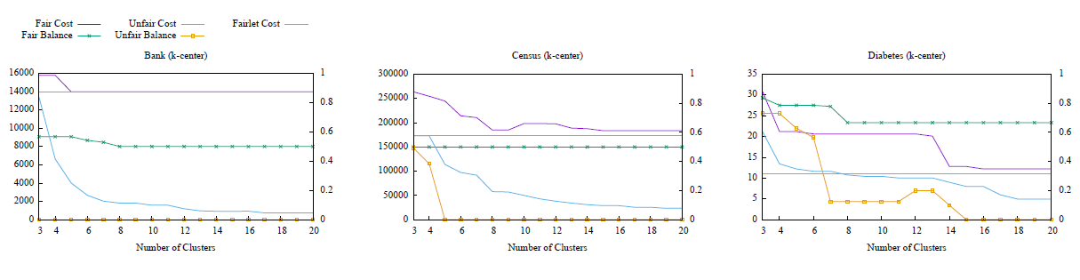
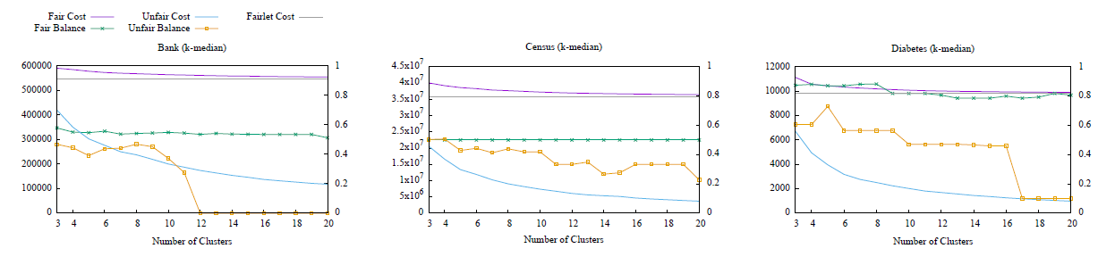
Results

Slide 16
Future Work
Extend this idea to situations where the protected class is not binary
Extend the idea to other clustering objective functions

Slide 17
References
Gonzalez, Teofilo F. "Clustering to minimize the maximum intercluster distance." Theoretical Computer Science 38 (1985): 293-306.[PDF]

Slide 18
THANK YOU

